Slide 1
Documentation with GitHub and Markdown
Jesse Driskill
July 16th, 2021
Notes:
Purpose: LM is used in place of the official licensing server to provide licenses to BIG-IP

Slide 2
What We Are Covering
Hint: still not everything
Using Markdown for nice looking documentation
Markdown syntax
Basic Use on Github
I’m well aware that several people on this call are far more experienced than I with Markdown. To those people I say, ”Be nice with your corrections”. (I’m looking at you, Wells.)

Slide 3
Why?
Because jan doesn’t like me
Markdown is simpler than HTML, allowing it to be used for well-formatted notes or documentation without losing (much) readability even when the ‘tags’ are uninterpreted.
Using it with Github allows you to create notes or documentation and immediately push it to the repo, providing a simple documentation repository with well-formatted notes, using only a simple text editor and a common directory.
Important note:
Several people on this call are far more experienced than I with Markdown. To those people I say, ”Be nice with your corrections”. I’m looking at you, Mr. Wells.

Slide 4
Markdown Basic Syntax

Slide 5
The Basics
Question: How does one make a syntax guide interesting?
Markdown allows you to focus more on the content rather than the formatting tags. Markdown allows the same flexibility as HTML, but with a simplified syntax that requires fewer characters to accomplish the same thing. A trivial example would be italicizing text. HTML requires wrapping the text in tags "<em>” and “</em>”, while Markdown accomplishes the same thing using asterisks (“*”).
Advantages
Fewer characters breaking up the actual text
More readable when the raw text is not interpreted, like in a basic text editor
More intuitive than HTML
HTML can be used within Markdown when native support isn’t present
Disadvantages
Duplicates existing HTML functionality
A whole new set of Markup tags to memorize
Not all HTML functionality is covered, leaving HTML as the only recourse

Slide 6
The Basics
Answer: they don’t
Trivial example:
HTML: <em>This text would be italicized</em>
Markdown: *This text would be italicized*
_This text would also be italicized_
**This text would be bold**
***And this would be bold + italicized***
_**So would this**_
There is far too much to Markdown for me to actually cover it all, or even a significant portion of it, in a single presentation. I have created an example GitHub repository to demonstrate the usage of several Markdown tags.
Real Cheat Sheet: https://www.markdownguide.org/basic-syntax#overview

Slide 7
Github + Markdown

Slide 8
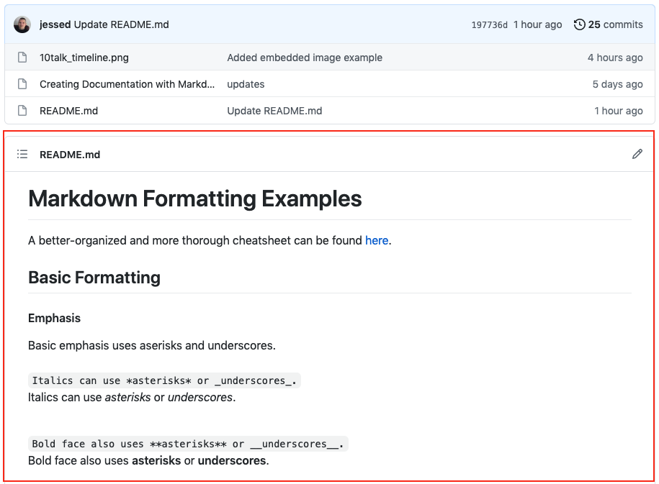
What About Using Markdown with GitHub?
Shame on me for Blatantly leveraging gregg’s repo
By default Github repositories contain a ‘README.md’. The readme is expected to use Markdown and the content will be displayed below the repository contents.
Gregg Marxer has leveraged the Github approach to documentation really well for the ASE onboarding repo here (sorry Gregg).

Slide 9
The Basics
Shame on me for Blatantly leveraging gregg’s repo
Gregg Marxer has leveraged the Github approach to documentation really well for the ASE onboarding repo here (sorry Gregg).

Slide 10
Questions?
Expectation of Correct answers not expressed or implied

